Slide 1
A MEMBER OF THE RUSSELL GROUP

Slide 2
“Change and decay in all around I see...”
David Taylor
School of Medicine

Slide 3
Change…
I have been in Liverpool for almost 30 years
I have survived one major and at least three minor curriculum changes
And effected/caused/helped at least four others in different parts of the world.

Slide 4
I believe in entropy

Slide 6
Creating Tomorrow’s Doctors
David Taylor

Slide 7
That is our task
Quite simply, to help our students learn to be the type of Doctor
that we would want them to be
that we would want to treat our parents or children
that we would want to treat us

Slide 8
Regulation

Slide 9
Outcomes
We have entered an era where we need to show that we meet measurable outcomes
This is true at undergraduate level but also licensing and re-validation

Slide 10
Standards
There is a real debate about what constitutes competence.
What is, in fact, “good enough”?
How do we measure it?
What is a pass mark?
Who says?

Slide 11
So much has changed
We know much more than we did
We know more about teaching than we did
Patients expect more than they did
It is not about “doing more”
It is about “doing it cleverer!”

Slide 12
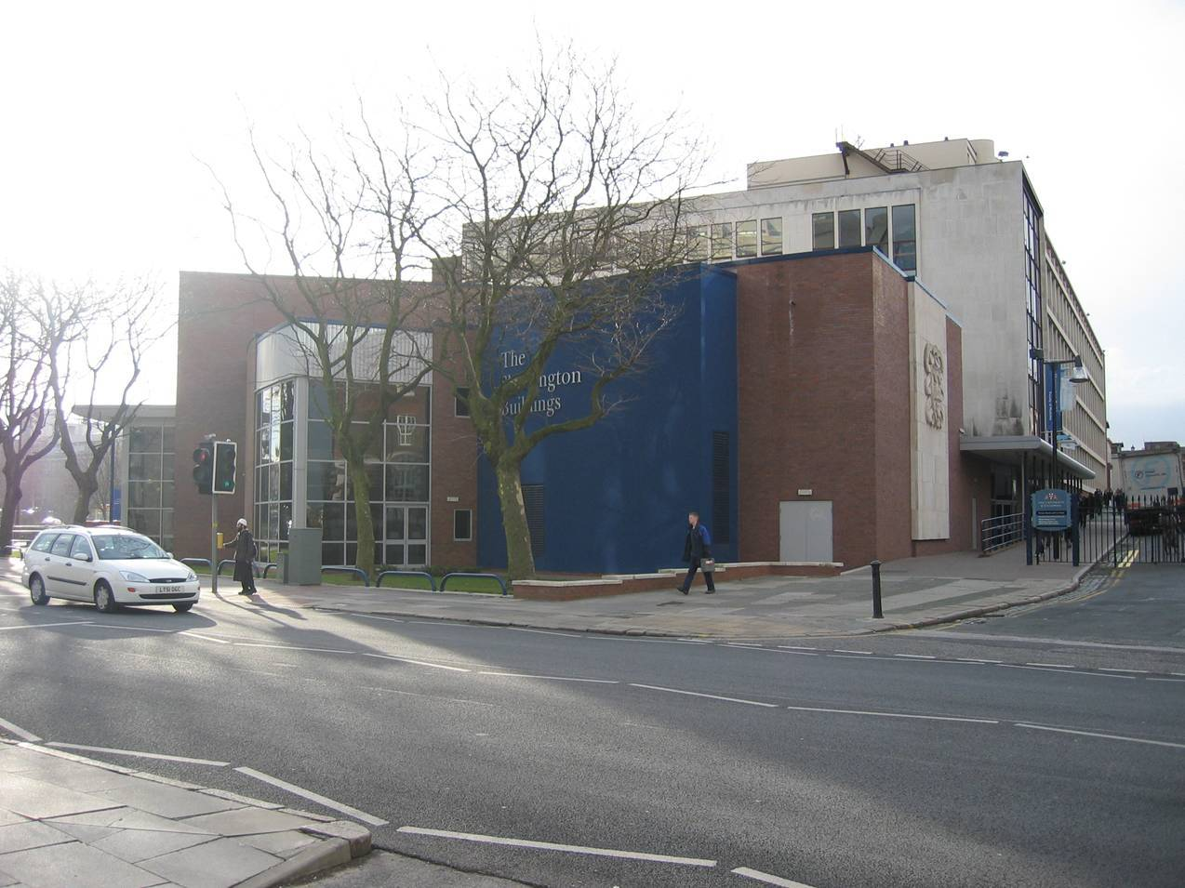
I come from Liverpool

Slide 13
I am from Liverpool
Our programme is developed around
Problem based learning
Clinical skills teaching
Learning in context
Balance between hospital and community
Obviously we still have lectures

Slide 14
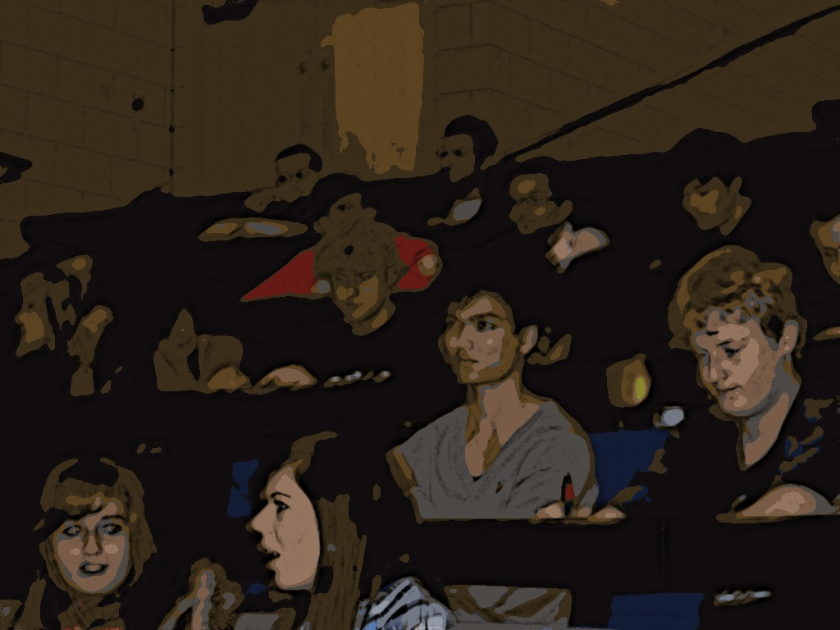

Slide 15
But
The route through the syllabus is determined by a series of clinical vignettes, which the students discuss in small PBL groups

Slide 16
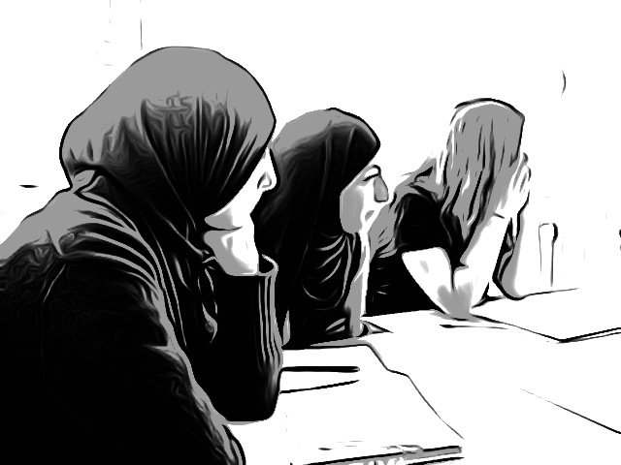

Slide 17
The Teacher role has developed
to include
being able to make small groups work well
Giving students confidence to say what they know
Giving students the responsibility for determining what they still need to know

Slide 18
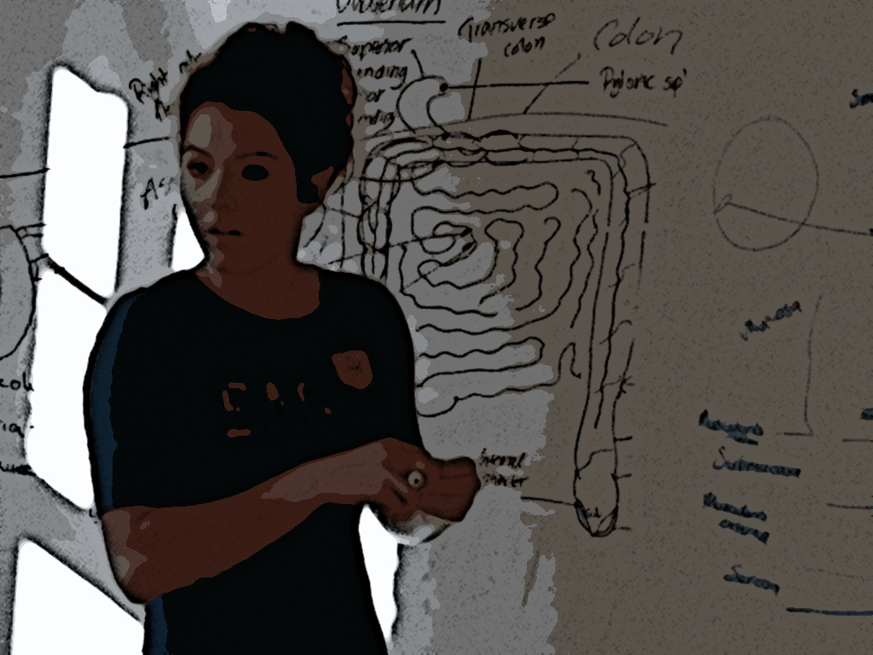

Slide 19
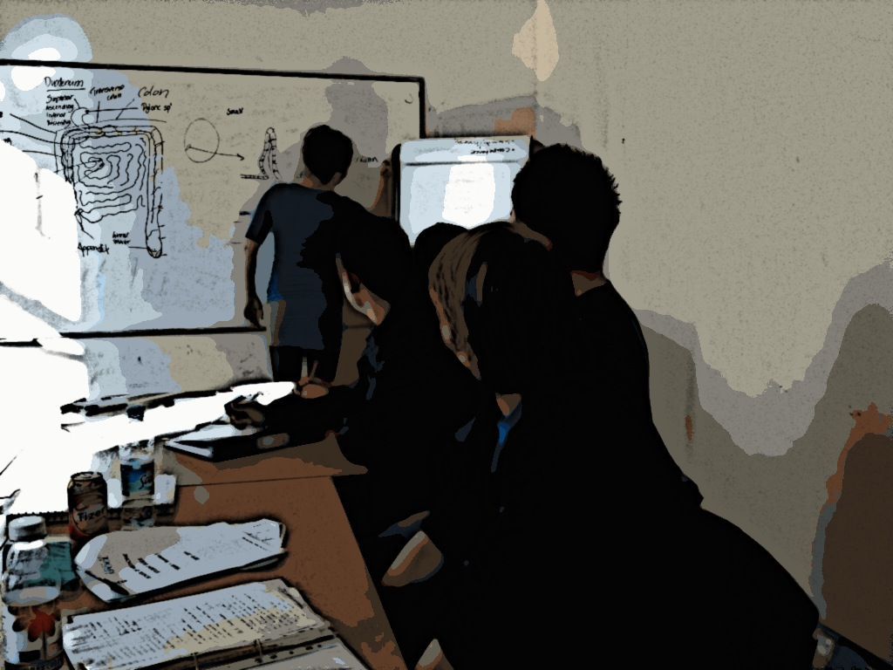

Slide 20
But
We are still expected to know what we are doing
We are still expected to challenge students

Slide 21
And
We get to know some of the students very well

Slide 22
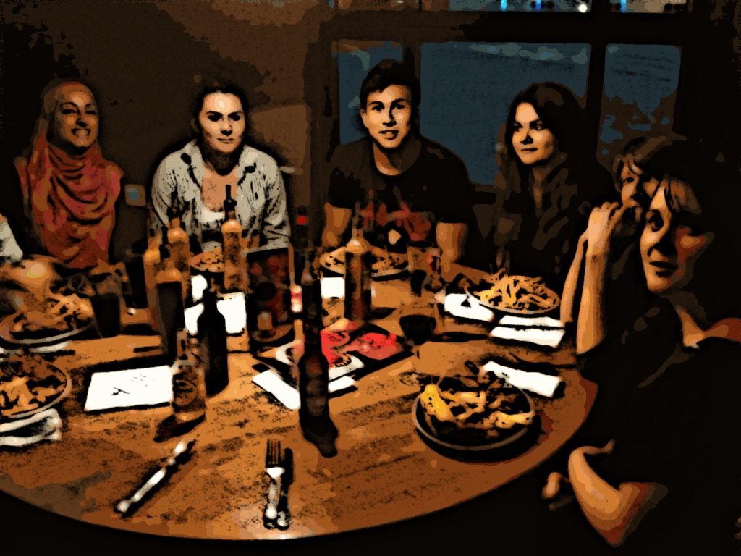

Slide 23
Taylor and Hamdy 2012
Reflect
and observe
Develop new concepts
Experiment or
articulate
Existing knowledge
Dissonance
Elaboration
Refinement
Start here
Feedback
Reflect
Consolidate
Reflect
organise

Slide 24
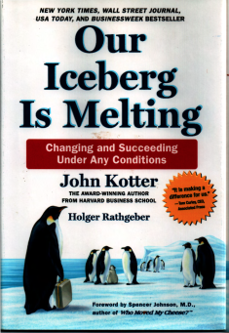
Kotter: Eight Step Process of Successful Change
Set the Stage
Create a Sense of Urgency
Pull Together the Guiding Team
Decide What to do
3. Develop the Change Vision and Strategy
Make it Happen
4. Communicate for Understanding and Buy In
5. Empower Others to Act
6. Produce Short-Term Wins
7. Don't Let Up
Make it Stick
8. Create a new Culture

Slide 25
Create a sense of urgency
In the UK this was done (and continues to be done) for us.
Tomorrow’s Doctors 1993,2003, 2009.....
And now the National Student Survey

Slide 26
Pull together the guiding team
We started in 1993 for a 1995 start
(which we delayed until 1996)
We needed to buy in experts
As well as nurture our own
Not everyone is an agent for change

Slide 27
Develop the change vision and strategy
Not “vision” - “Change vision”
The key to this is the route rather than the end point
Involve as many key players as possible

Slide 28
Communicate for understanding and buy-in
The skill comes in choosing the right communicators.
Trust and respect are key

Slide 29
Empower others to act
But in such a way that it is difficult for them to derail the system...
Involve as many people as possible in the planning and development

Slide 30
Produce short term wins
The short term win decided on by my institution was that it would be cost neutral to the departments.
So there was no money for the changes, and the departments STILL have the money.

Slide 31
Don’t let up
When all else fails, go back to the original vision and philosophy.
Do those things still hold good?

Slide 32
Taylor and Hamdy 2012
Reflect
and observe
Develop new concepts
Experiment or
articulate
Existing knowledge
Dissonance
Elaboration
Refinement
Start here
Feedback
Reflect
Consolidate
Reflect
organise

Slide 33
Create a new culture
Slowly but surely the “new” will become the “familiar”.
But even after 16 years
we still have staff referring to the “new” curriculum....
And ignoring the evidence.

Slide 34
Remember two things
Take a long-term perspective
And
1 Thessalonians 5:21

Slide 35
1 Thessalonians 5:21
Test all things. Hold fast to that which is good.

Slide 36
Taylor and Hamdy 2012
Task
Resources
Motivation
Stage of Development
Learning style
Reflect
and observe
Develop new concepts
Experiment or
articulate
Existing knowledge
Dissonance
Elaboration
Refinement
Start here
Feedback
Reflect
Consolidate
Reflect
organise

